Slide 1
TUN Data Challenge
Hire Heroes USA
Group 3: Hope Spenik, Arthur Johne, Michael Calvelli, Ryan Castro, Jessica Lavrinovich

Slide 2
The Questions:
Is there a geographic location within the US that most of our individual donors come from?
Do our social media posts or fundraisers calling for donations hit these areas with little to no donors?

Slide 3
Motivation
Individual Donors Grassroots Fundraising
Core Benefits:
Establishes relationships
Sustained giving and participation
Grounded, broad support of HH’s mission

Slide 4
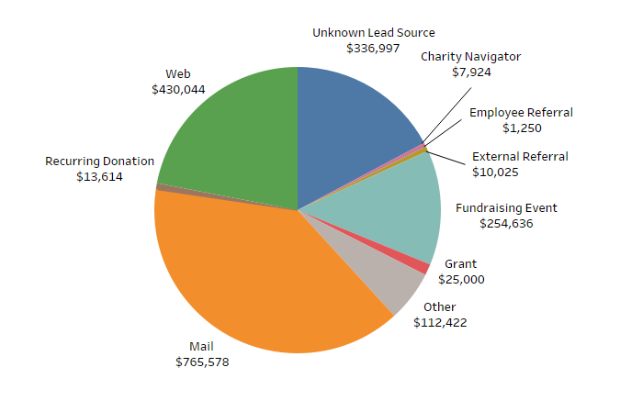
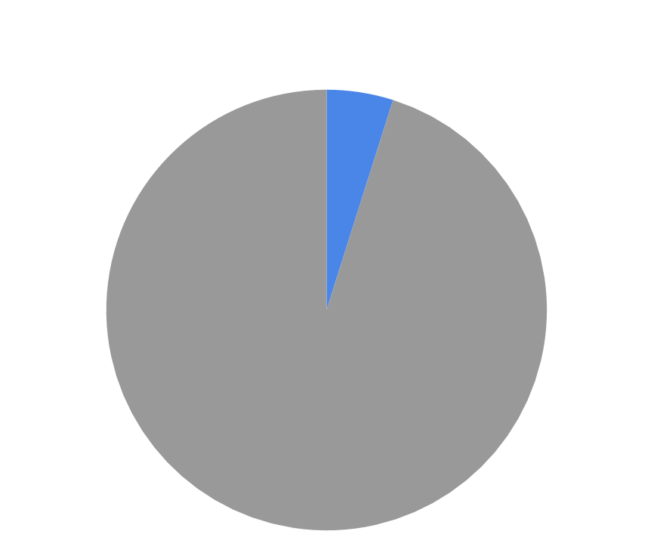
Mail & Web - Top Lead Source
Donors by By Donation Amount (2007-2019)
4.9%
Total Individual Donor Donations: $1,962,319

Slide 5
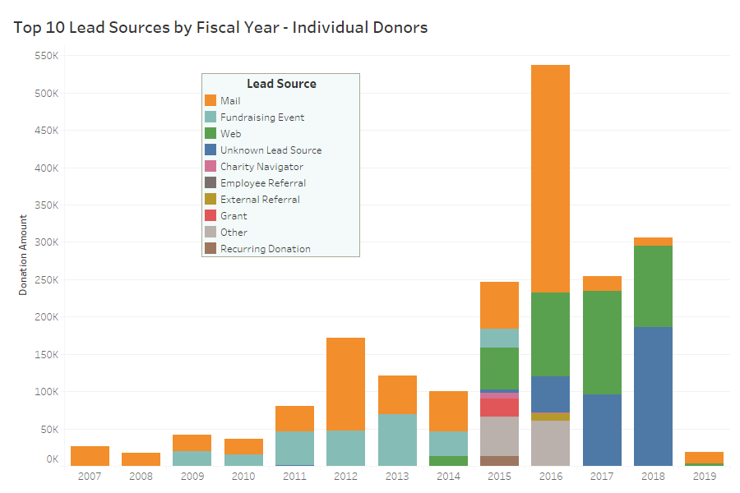
Top 10 Lead Sources by Fiscal Year - Individual Donors

Slide 6
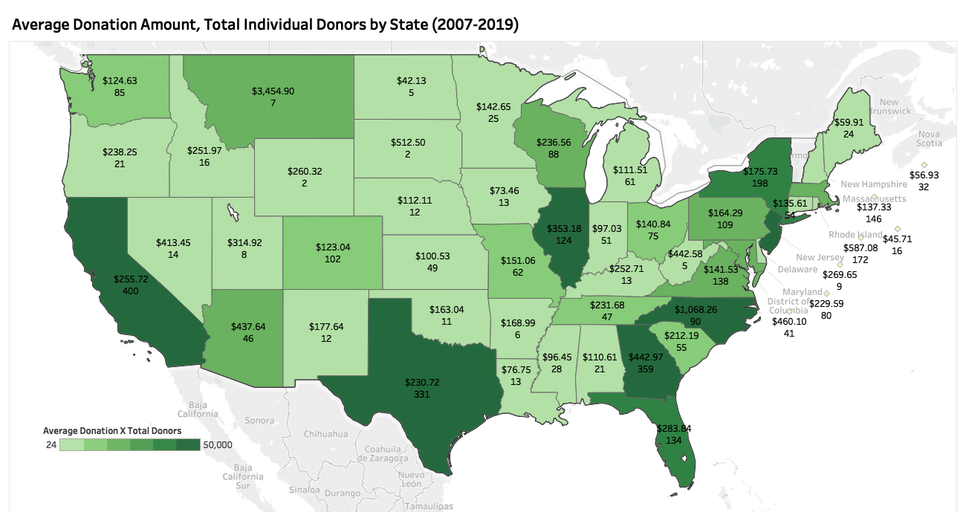
States to Focus On

Slide 7
States to Focus On
GA, CA, TX, NJ
FL, NY, IL, NC, VA, PA, OH, WA
Strong Donor States
High Potential
Notes:
Strong donors: high number of donors, high avg donations
Potential: either low donors and high avg donation, or vice versa

Slide 8
Recommendations
Prioritize high potential states
Grow and maintain strong donor states
Re-establish Mail as a primary lead source
Better data tracking

